Slide 1
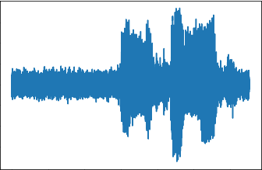
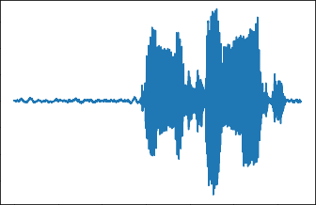
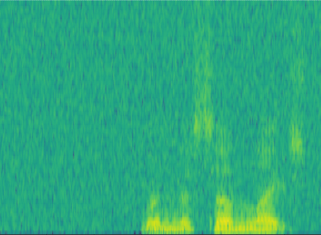
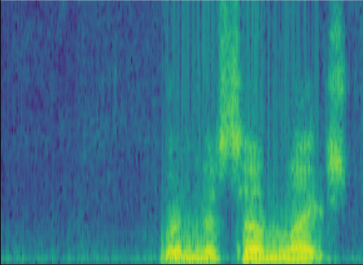
Sub-Sampler
STFT
Net
ISTFT
Loss→Update Net
Masking
Donwsampling
SDFU
CMFFU
Decoder
Input Noise
Downsampling
Encoder
Decoder
Upsampling
Output Denoised
CConv2d
SDFU
ReLU
CBN
CMFFU
CBN
RuLU
Encoder
Decoder
CDeconv2d
Encoder
SDFU
CMFFU
Decoder
CMA
Encoder
Decoder
Upsampling
Donwsampling
SDFU
CMFFU
CMA
Upsampling
Encoder
CSFU
Upsampling
Output Denoised Spectrogram
Input Noise Spectrogram
CMA
Complex Multi-scale attention Module
SDFU
Spectrum dynamic focusing Unit
Downsampling
Complex Scope Fusion Unit
Complex Multi-Scale Feature Fusion Unit
CSFU
CMFFU
Sub-Sampler
STFT
Net
ISTFT
Loss→Update Net
Masking
Donwsampling
SDFU
CMFFU
Decoder
Input Noise
Downsampling
Encoder
Decoder
Upsampling
Output Denoised
CConv2d
SDFU
ReLU
CBN
CMFFU
CBN
RuLU
Encoder
Decoder
CDeconv2d
Encoder
SDFU
CMFFU
Decoder
CMA
Encoder
Decoder
Upsampling
Donwsampling
SDFU
CMFFU
CMA
Upsampling
Encoder
CSFU
Upsampling
Input Noise Spectrogram
Downsampling
SDFU
Spectrum dynamic focusing Unit
Output Denoised Spectrogram
CSFU
Complex Scope Fusion Unit
CMFFU
Complex Multi-Scale Feature Fusion Unit

Slide 2
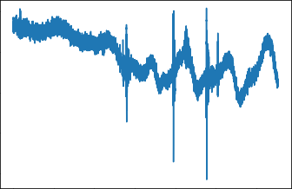
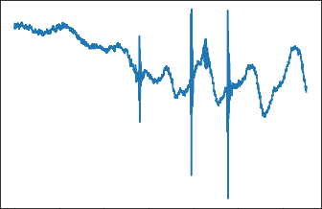

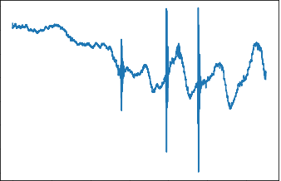
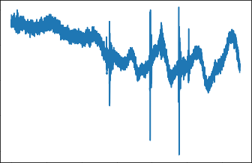
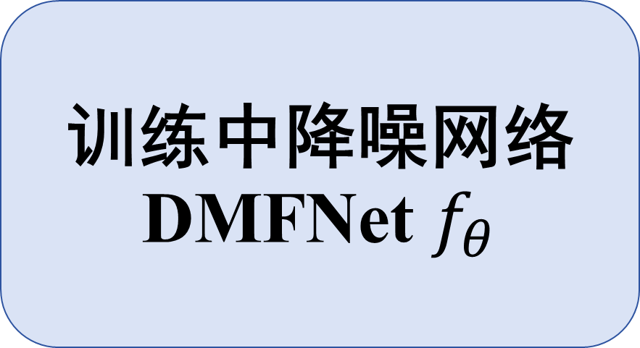
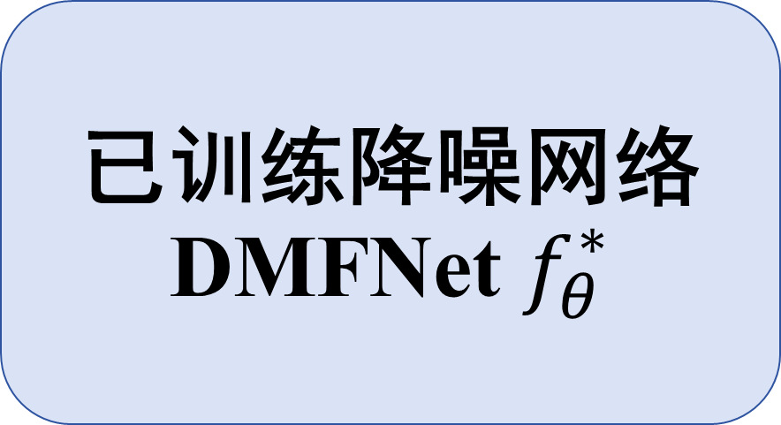
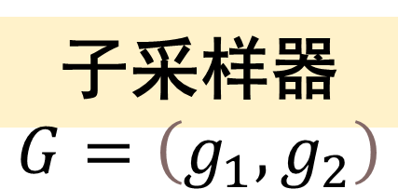
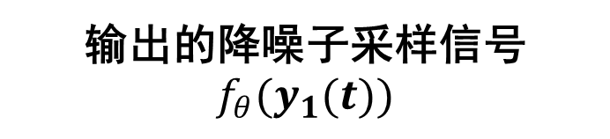
已训练降噪网络
DMFNet $f_{θ}^{∗}$
输入的原始音频信号
降噪后的音频信号
训练阶段
训练中降噪网络
DMFNet $f_{θ}$
子采样器
$$G=\left(g_{1},g_{2}\right)$$
子采样信号 y₁(t)
输出的降噪子采样信号$f_{θ}(y_{1}(t))$
计算损失
更新网络
子采样信号 y₂(t)

Slide 3
g(1)
mask₀
0
1
1
0
1
0
0
1
...(8)
Reshape
y₁(t)
n(2)
n(3)
n(5)
n(8)
...(8)
n(t)
n(1)
n(2)
n(3)
n(4)
n(5)
n(6)
n(7)
n(8)
...(8)
g(2)
mask₁₎
1
0
0
1
0
1
1
0
...(8)
y₂(t)
n(1)
n(4)
n(6)
n(7)
...(8)
Reshape

